Slide 1
jQuery
intro
PHP web development 2019/2020
Milena Tomova
Vratsa Software
https://vratsasoftware.com/

Slide 2
Content
Introducing jQuery
Ways of adding jQuery to a project
Useful resources
Selecting elements and modifying the DOM
Traversing the DOM
Add/Remove elements
jQuery objects
jQuery events, preventDefault()

Slide 3
jQuery

Slide 4
Introducing jQuery
jQuery
an open-source JavaScript library
not the only one JS library
but the most popular and widly used
provides
cross-browser compatibality
simpler syntax
DOM elements are easier to select and traverse
easier to create elements
easier to manage events
easier to handle Ajax requests

Slide 5
Introducing jQuery
Why is jQuery so popular?
Why is jQuery so popular?
jQuery is easy to study
jQuery easy to expand
jQuery is light
A lot of developers contribute to jQuery features development and maintanence
Using jQuery won`t be enough -
you will still need to use vanilla JavaScipt!

Slide 6
Ways of adding jQuery to a project

Slide 7
Ways of adding jQuery to a project
Download jQuery files and link them to the project
Use a CDN /preferable/

Slide 8
Useful resources

Slide 9
https://jquery.com/ Zak Ruvalcaba, Anne Boehm - Murach's jQuery, Nth edition (Training & Reference)
Ray Nicholus, Beyond jQuery
Jason Lengstorf, Keith Wald - Pro PHP and jQuery (2nd Edition) (The Expert's Voice in Web Development) - 2016

Slide 10
Selecting elements and modifying the DOM

Slide 11
Selecting elements and modifying the DOM
Selecting elements from the DOM resembles the JS DOM element selection
jQuery(selector) = $(selector)
full version short version
select element
//by tag //by id
$("div") $("#navigation")
//by class //by combination of selectors
$(".menu-item") $("ul.menu li")

Slide 12
Selecting elements and modifying the DOM
Calling methods
select elements to call a method on
call a method -
Almost always the selection returns a collection of elements!
let element = $(‘selector’);
element.methodName(parameter);

Slide 13
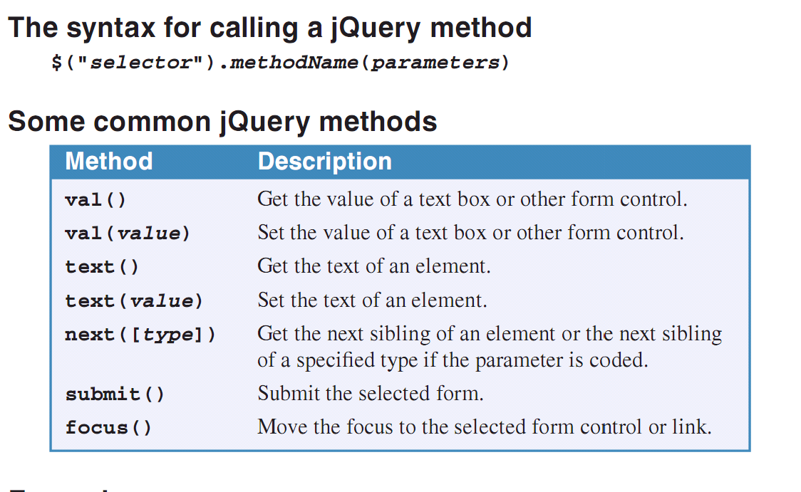
Selecting elements and modifying the DOM

Slide 14
Traversing the DOM

Slide 15
Traversing the DOM
select element /get a jQuery object to apply the jQuery methods on/
let element = $(selector);
Then use the jQuery object properties for
Next and previous siblings, Parents and children
let nextSibling = element.next([selector])
//next sibling
let prevSibling = element.prev([selector])
//previous sibling
nextSibling, prevSibling - new jQuery object are returned

Slide 16
Traversing the DOM
nextSibling, prevSibling - new jQuery object are returned
If a jQuery object - you can apply jQuery object`s methods!
Else - you will get an error!

Slide 17
Traversing the DOM
element.parent([selector])
//returns the immediate parent of each of the element the method is applied to
element.parents(selector)
//returns the parent that is selected with the given selector

Slide 18
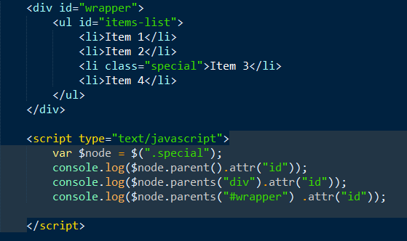
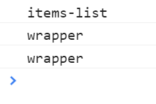
Traversing the DOM

Slide 19
Add/Remove elements

Slide 20
Add/remove elements
jQuery.appendTo()/prependTo()
jQuery stands for the jQuery object -
the element from the DOM selected or created using jQuery
Using JS document.getElement…
document.querySelect…
document.createElement….
methods won`t create (a) jQuery object/s!

Slide 21
Add/remove elements
create an element - a jQuery object
let hElement = $(‘<h1>header</h1>’)
create elements - jQuery objects
let multipleElements = $("<ul><li>Hello</li></ul>")

Slide 22
Add/remove elements
jQuery.appendTo()/prependTo()
$("<ul><li>Hello</li></ul>").appendTo("body");
jQuery.append()/prepend()
$("body").prepend("<h1>header</h1>");

Slide 23
Add/remove elements
<div class="container">
<div class="inner">
<p>First Paragraph</p>
<p>Second Paragraph</p>
</div>
</div>
$(‘p’).remove();
//will remove all p-elements from the document
$(‘.inner’).remove();

Slide 24
jQuery objects

Slide 25
jQuery objects
addClass(), removeClass(), toogleClass()
on(event, callback) //for events listening and handling
animate(), fadeIn(), etc…
The jQuery objects have more
methods and properties than JavaScript DOM objects.

Slide 26
jQuery objects
jQuery.css("color", "#f3f")
jQuery.html()
returns the innerHTML
jQuery.html(content)
sets the innerHTML
jQuery.text(content)
sets and escapes the innerHTML
jQuery methods for changing the DOM elements

Slide 27
jQuery events

Slide 28
jQuery events
function onButtonClick(){
$(".selected").removeClass("selected");
$(this).addClass("selected");
}
$("a.button").on("click", onButtonClick);
$(this) is the event target
jQuery has methods
for adding on()
and removing events off()

Slide 29
jQuery events
jQuery.preventDefault()
used to stop the default behaviour of an element when an event is triggered.
Clicking submit button, submits the form.
Clicking a tag, leads to its href or reloads the page when href is missing.
To be able to validate form data with JS before submition -
submitButton.preventDefault()
To use an a-element for a slider control button -
aElement.preventDefault()
in the event handler methods.

Slide 30
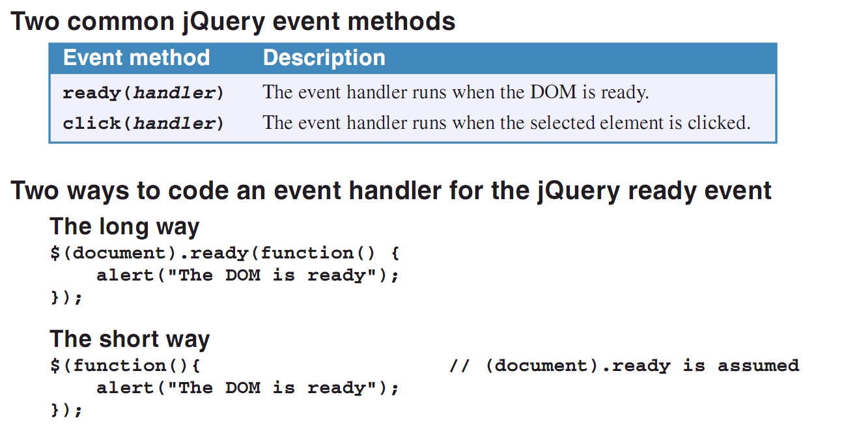
jQuery events

Slide 31
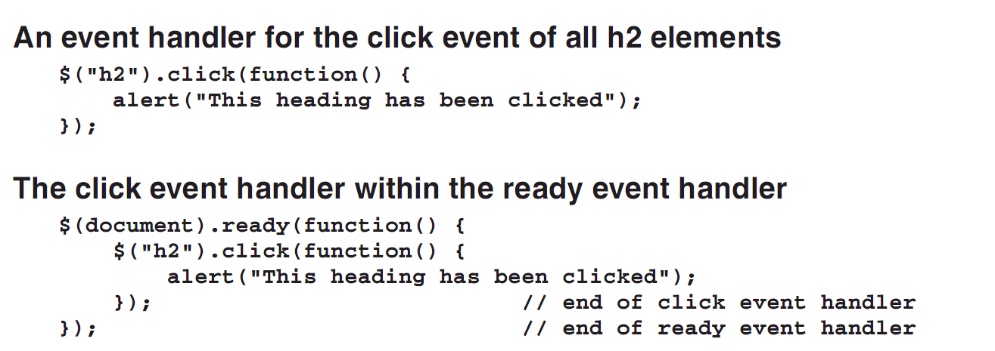
jQuery events

Slide 32
click() won`t work on elements that do not exist in the DOM when the document is loaded in the browser /elements created and added to the DOM afterwards/.
Always use on() instead on element(s) that are part of the DOM when the document is initially loaded in the browser.

Slide 33
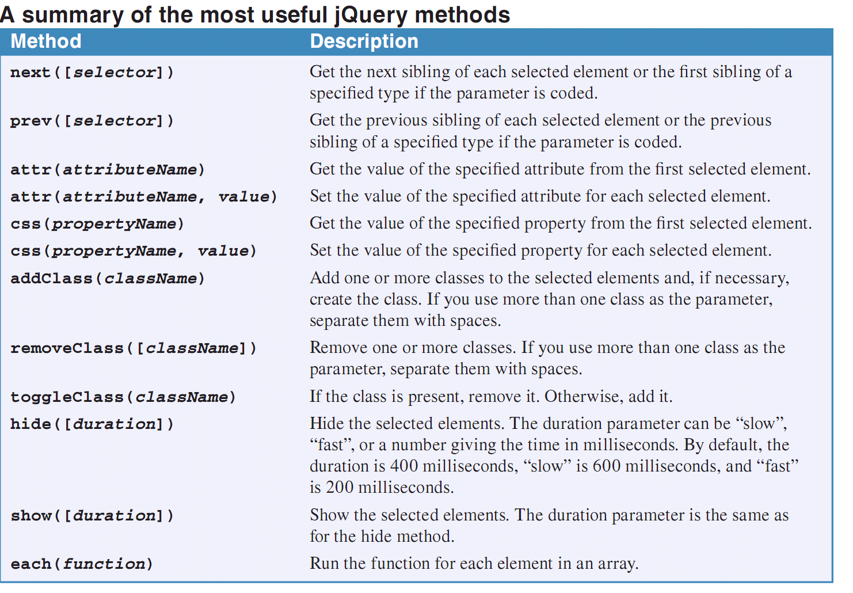
jQuery events

Slide 34
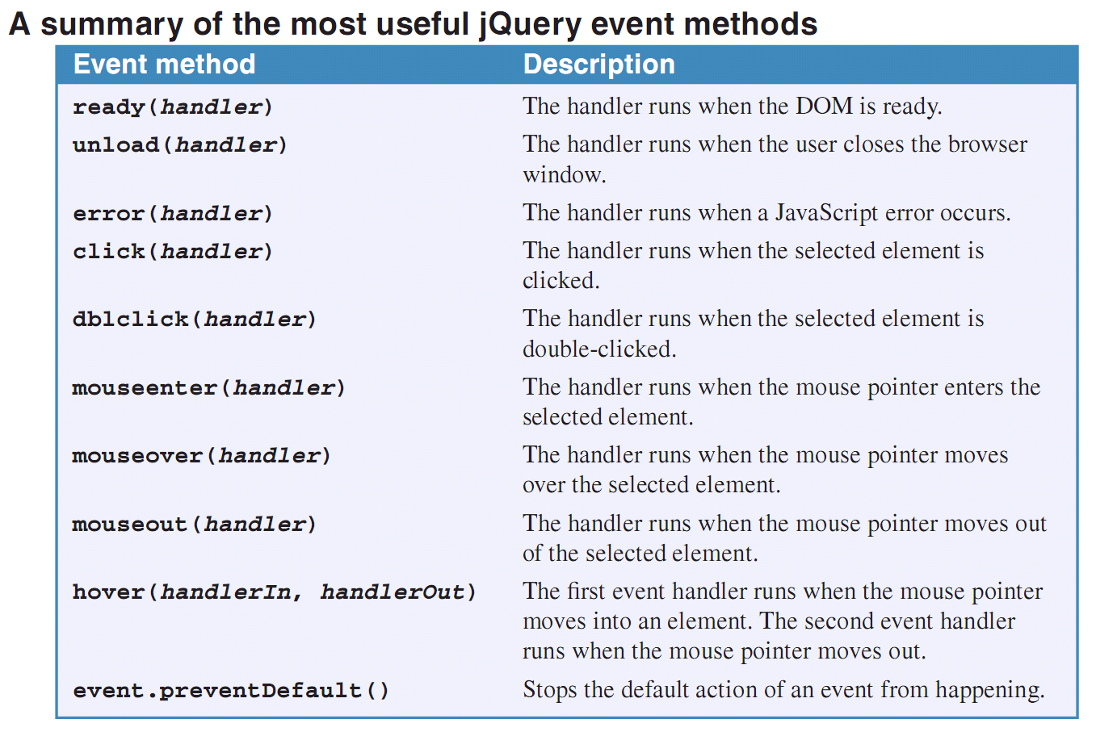
jQuery events

Slide 35
jQuery chaining methods

Slide 36

jQuery chaining methods
jQuery methods always return a result or this
So you can chain jQuery methods -
the next method is applied on the result of the previous method.
$('<button>')
.addClass('btn-success')
.html('Click me for success')
.on('click', onSuccessButtonClick)
.appendTo(document.body);

Slide 39



Trainings @ Vratsa Software
Vratsa Software – High-Quality Education, Profession and Jobs
www.vratsasoftware.com
The Nest Coworking
www.nest.bg
Vratsa Software @ Facebook
www.fb.com/VratsaSoftware
Slack Channel
www.vso.slack.com

